Slide 1

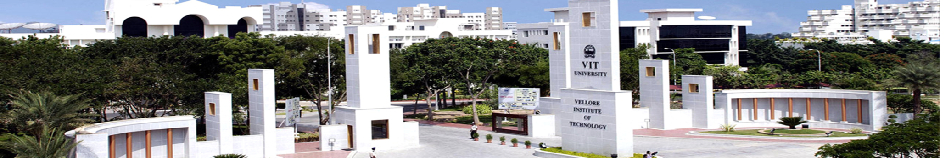
FINAL REVIEW
Ranganathan S V - 18BME0374
Sridharan A P - 18BME0510
Winter 2021 - 2022: Capstone Project Presentation
Prof. Ponnambalam S G
Project Guide
PROJECT ID : 21BTECH10158
School of Mechanical Engineering
29-04-2022

Slide 2

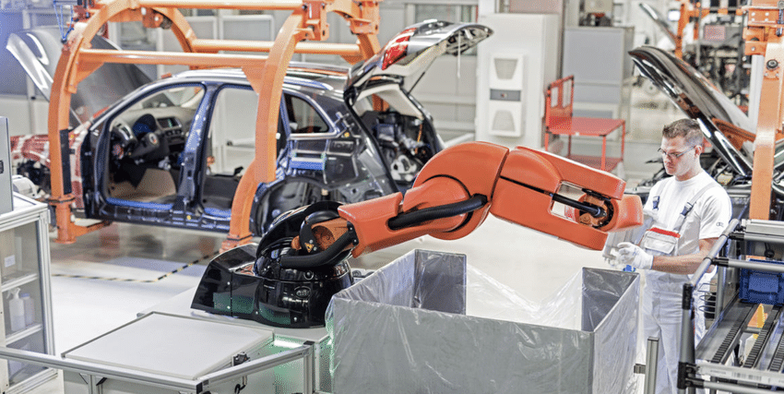
Efficient Application of Metaheuristic Algorithms for Balancing Human Robot Collaborative Assembly Lines

Slide 3

INTRODUCTION
PROBLEM DESCRIPTION
LITERATURE REVIEW
LITERATURE GAP
METHODOLOGY
RESULTS & DISCUSSION
CASE STUDY
CONCLUSION
MILESTONES
REFERENCES

Slide 4
INTRODUCTION

Slide 5
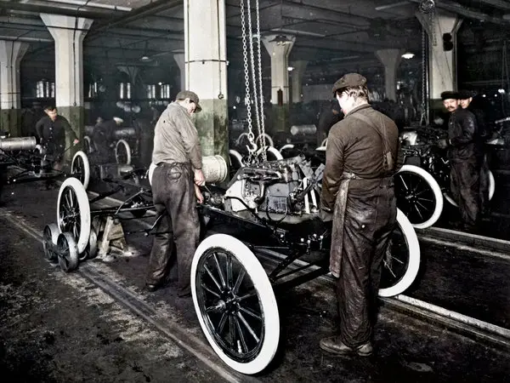
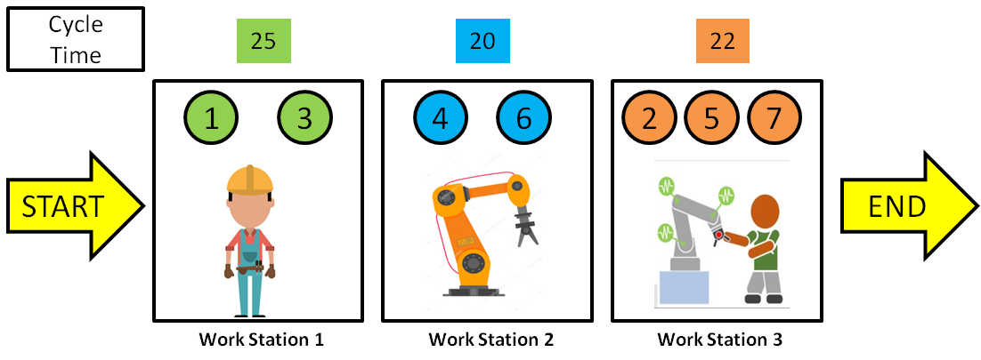
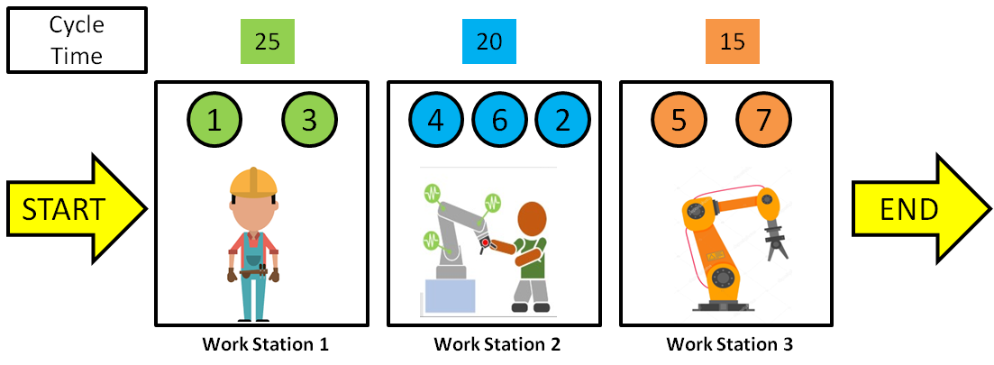
ASSEMBLY LINE
Assembly Line – first developed by Ford Motor Company in 1900s.
On December 1, 1913, Henry Ford installs the first moving assembly line for the mass production of an entire automobile. His innovation reduced the time it took to build a car from more than 12 hours to one hour and 33 minutes.
What is meant by Balancing?
The process of equalizing the amount of work at each workstation on an assembly line.
To work effectively, with proper allocation of resources in each workstation.
Why to Balance Assembly line?
Improvement of
efficiency
production rate
productivity
Reduction of
cycle time
production cost
Energy consumption

Slide 6

HUMAN ROBOT COLLABORATION IN ASSEMBLY LINE BALANCING
As the automation in manufacturing department is increasing significantly, several robots are developed to carry out several tasks to increase the production rate. However, not all tasks can be automated due to the lack of flexibility with available robotic technologies.
Humans on the other hand are flexible, adaptable according to market demands, and also have decision making skills with creativity.
To remain relevant, many manufacturing enterprises show interest in human robot collaboration where the skills of human and the speed, endurance, and accuracy of robots are brought together to increase production. This also helps the human workers as the repetitive and stressful tasks are done by robots.
Work 24 hours a day without fatigue
High productivity
Quality of product
Flexible & Adaptable
Less investment
Less energy consumption
Not as flexible as HRCAL
Huge investments
More energy consumption
Can’t work continuously
Less productivity
Needs a lot of training for high quality

Slide 7
2. PROBLEM DESCRIPTION

Slide 8
PROBLEM DEFINITION
To improve the balancing and scheduling of Human-robot collaborative assembly line operations.
Considering the assembly line structure of StAL (straight line assembly line) where a single product is assembled with a known number of workstations
To optimize CYCLE TIME, OVERALL LINE ENERGY CONSUMPTION, with an overall IMPROVEMENT IN ERGONOMIC, ECONOMIC & LAYOUT CONSTRAINTS.
To consider setup times, sequence dependent times and resource allocation constraints that haven’t been considered to solve human-robot ALB problems so far.
To carry out a case-study in a semi-automated industrial assembly line, to improve the multiple line objectives by automating an existing manual sub-assembly and validate the performances and functioning of the developed algorithms in allocating an optimal operations strategy

Slide 9
3. LITERATURE REVIEW

Slide 10
Title of the paper | Journal & Year | Authors | Description/ Remarks
An analysis of task assignment and cycle times when robots are added to human-operated assembly lines, using mathematical programming models. | International journal of production economics, 2021 | Tamas ´ Koltai, Imre Dim´eny, Viola Gallina, Alexander Gaal, Chiara Sepe. | Puts forth three different layouts for human-robot assembly line (only human/both in a workstation/both in different workstations). An MILP approach to solve every scenario was formulated, which was referred for our problem synthesis.
Identification and classification of risk factors for human-robot collaboration from a system-wide perspective. | Computers and industrial engineering, 2022. | Nicole Berx, Wilm Decre, Ido Morag, Peter Chemweno, Liliane Pintelon. | Tabulates all possible risks in a human-robot collaborative assembly line environment, along with precedence insights of every risk. Risks are referred to effectively formulate our problem in objective of increasing ergonomics.
Balancing of assembly lines with collaborative robots. | Business Research, 2019 | Christian Weckenborg, Karsten Kieckhafer, Christoph Muller, Martin Grunewald, Thomas S. Spengler | RALB problem solution approaches and considerations that weren’t accounted for previously.

Slide 11
Title of the paper | Journal & Year | Authors | Description/ Remarks
Multi-objective migrating bird optimization algorithm for costoriented assembly line balancing problem with collaborative robots. | Neural Computing and Applications (2021) | Zixiang Li, Mukund Nilakantan Janardhanan, Qiuhua Tang. | The complete methodology of MBO algorithm applied for assembly line balancing with collaborative robots. Provides insights on hybridisation of MBO and use of NSGA-II for solving multi-objective problems.
Balancing and scheduling assembly lines with human-robot collaboration tasks | Computers and operations research 140 (2022) | Amir Nourmohammadi, Masood Fathi, Amos H.C. Ng | In addition to the traditional ALBP constraints, this paper is referred for human and robot characteristics in terms of task times, allowing multiple humans and robots at stations, and their joint/collaborative task formulations. Also, how real time industrial case study is carried out.
Designing human-robot collaboration (HRC) workspaces in industrial settings: A systematic literature review | Journal of Manufacturing Systems 62, 2022 | Ana Correia Simoes, Ana Pinto, Joana Santos, Sofia Pinheiro, David Romero | A framework that represents the complexity levels of the influencing factors in H-R workplace. The guidelines and recommendations from literature are categorised into 3 groups of H-R design layout and considerations, with increasing order of complexity.

Slide 12
Title of the paper | Journal & Year | Authors | Description/ Remarks
Archimedes optimization algorithm: a new metaheuristic algorithm for solving optimization problems | Applied Intelligence, 2020 | Fatma A. Hashim, Kashif Hussain, Essam H. Houssein, Mai S. Mabrouk, Walid Al-Atabany. | Shows the implementation methodology of AOA algorithm, its meaning and significance for solving optimization problems.
An efficient Balanced Teaching-Learning-Based optimization algorithm with Individual restarting strategy for solving global optimization problems. | Elsevier, 2021 | Ahmad Taheri, Keyvan RahimiZadeh, Ravipudi Venkata Rao. | Balanced TLBO (BTLBO), introduced two new phases; tutoring and restarting phase, providing a balance between exploitation and exploration capabilities. Emphasis on increasing the possibility in finding the global optima.
Multi-objective discrete particle swarm optimisation algorithm for integrated assembly sequence planning and assembly line balancing | SAGE Journal, 2016 https://doi.org/10.1177/0954405416673095 | Ab Rashid, M. F. F., Hutabarat, W., & Tiwari, A. | Insights on commands for every arithmetic operations involved in PSO equations. Was used to gain an understanding to deal with problems that needs to maintain the population members’ values within context.

Slide 13
4. LITERATURE GAP

Slide 14
LITERATURE GAP
Since the study started on RAL BP, only 33 articles were published till date since 1991(over 30 years). The research on this field was less and skyrocketed recently (2015-2019).
Since 1997, most of the researchers started using deterministic variable task times that were determined on the types of robots. This was due to the development in technology that resulted in invention of many different robots that can perform all the tasks.
Mathematical models were used to describe the relations between the different objectives and to handle the constraints effectively. As the size of the problem increased, meta-heuristics started dominating the other methods. Many meta-heuristics were developed to tackle this NP-hardness of the RALBP.
Introduction of Cobots(collaborative robots) to the assembly line, created a new trend in the research area of RALBP. This use of cobots in the assembly line showed better results and gained interest by many industries. As this area of research is quite new, only few papers were published since 2019.
Many real life constraints such as tools assignment, tool space optimization, etc.., were not addressed in most of the papers and this could be the future in the study of RAL BP.

Slide 15
LITERATURE GAP
Almost all the research on RALBP assume fully automated assembly line which requires huge investments. Not all the industries are capable to do such investments and still many of the industries slowly started to introduce robots in their assembly lines. So the study on human robot collaboration assembly line could be a great research area as many industries opt them as they are easy and require less investment.
The studies that included cobots in the assembly line mostly preferred only one robot in a workstation. Research study on multiple robots and humans working in parallel could be a great area of research. As humans started working alongside robots, study of ergonomics and real life constraints such as human fatigue, sequence dependent setup times, tool and accessory changing, part transportation between stations, etc.., can be included in RABLP as no one has ever did that previously due to its high complexity.
Most industries focus on only one objectives while designing assembly lines rather than many. Research on Multi objective optimizations could be more relevant to real life problems. As introduction of multi objectives create more complexity, many meta-heuristics were developed. From the recent studies, hybrid metaheuristics showed better results than meta heuristics. So study on hybrid metaheuristics on solving multiple objectives could create a way for finding better pareto optimal solution sets.

Slide 16
LITERATURE GAP
In-line with the growing interests and developments in human-robot collaborative assembly line balancing problems using metaheuristics, “standard testing datasets” of different task sizes for H-R ALBP aren’t available for researchers who may use such reliable and readymade datasets to test different algorithms.
Due to several intricate considerations in designing a H-R collaborative assembly line, a broad range of publications in this little researched domain haven’t “collectively” emphasised flexible and realistic constraints with respect to individual task abilities of humans and robots, collaborative work safety, economic production. (COLLECTIVELY DEVELOPED CONSTRAINTS FOR OUR PROBLEM SHALL BE DEMONSTRATED)
A very recent algorithm called “ARCHIMEDES OPTIMISATION ALGORITHM” or AOA is implemented to solving our H-R ALB problem. This algorithm is very recent, has less development fatigue and importantly, has never been used for solving any line balancing problems before. To make things interesting, this algorithm performs slightly better than all algorithms considered by us for our problem (SHOWN IN RESULTS SECTION)

Slide 17
5. METHODOLOGY

Slide 18

DATA GENERATION

Slide 19
DATA REQUIRED & SOME ASSUMPTIONS MADE FOR HRC
Number of tasks
Number of workstations
Number of types of robots available
Operation time table for all robots, cobots and the human
Setup times for robots
Sequence dependent times for robots
Precedence matrix
Energy Consumption by robots and the human
Some of the assumptions made while generating the data are,
Number of cobots = Number of robots
Cobot_i = Robot_i + Human
Only one type of worker (all workers are equally skilled)
The lower bound and upper bound of operation times are used for calculation of lower and upper bounds of other data (setup time, sequence dependent time).
Energy consumption of robots and the human is given in Wh/min. [0.10 - 0.90] Wh / min

Slide 20
TUNING PARAMETERS USED
Number of tasks
Number of robots
Lower bound(lb) and upper bound(ub) for operation time of robots table
a1, a2, a3, a4 (parameters [range from 0 to 1] that control the lower and upper bounds of setup time and sequence dependent time)
DESCRIPTION | FORMULAE
Lower limit of task time for robot [type i] | lb
Upper limit of task time for robot [type i] | ub
Lower limit of setup time for robot [type i] | a1 * lb
Upper limit of setup time for robot [type i] | a1 * ub
Lower bound of sequence dependent time for robot [type i] | a2 * lb
Upper bound of sequence dependent time for robot [type i] | a2 * ub
Lower limit of task time for cobot [type i] | lb- (a3 * (ub - lb))
Upper limit of task time for cobot [type i] | ub - (a3 * (ub - lb))
Lower limit of task time of human | lb + (a4 * (ub - lb))
Upper limit of task time of human | ub + (a4 * (ub - lb))

Slide 21
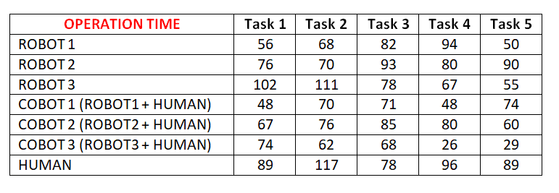
OPERATION TIME
Is assumed to be in minutes and the data type used is integer
Dimension = r X n, where
r = (number of robots * 2) + 1
n = number of tasks

Slide 22
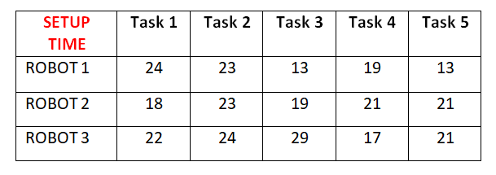
SETUP TIME
Is assumed to be in minutes and the data type used is integer
Dimension = r X n, where
r = number of robots
n = number of tasks

Slide 23
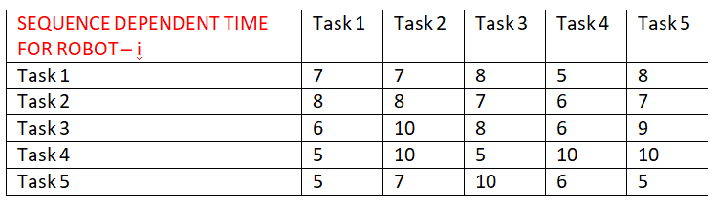
SEQUENCE DEPENDENT TIME
Is assumed to be in minutes and the data type used is integer
Dimension = r X [ n X n ], where
r = number of robots
n = number of tasks

Slide 24
ENERGY RATING
The data is in from or array where the energy consumption per min of robots and the human is given. Data type used is double.
Dimension = 1 X (r+1), where
r = number of robots

Slide 25
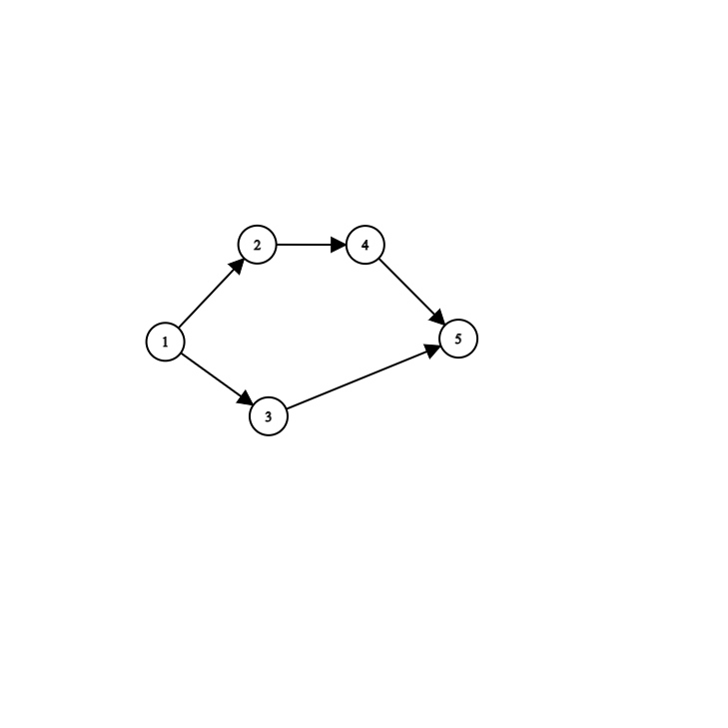
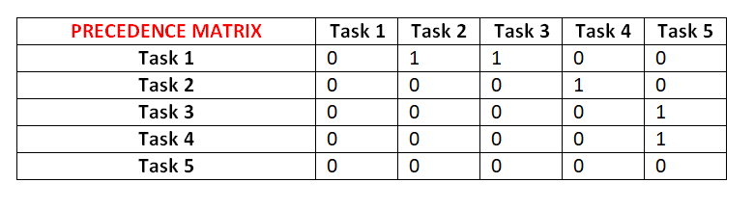
PRECEDENCE MATRIX
The data in this matrix is either 0 or 1 where 0 means no precedence relation and vice versa.
Dimension = n X n, where
n = number of tasks

Slide 26

REAL WORLD CONSTRAINTS

Slide 27
HUMAN ROBOT COLLABORATION IN ASSEMBLY LINE BALANCING
TASK CONSTRAINTS with respect to the ability of each type of robot, cobot(human+worker) and human in carrying out each individual task are taken into account. Inculcation of task constraints proves flexible and realistic for any entity that needs a fix to their semi-automated assembly line. In our problem, we take this into account by defining a constraint matrix that defines the “task ability/disability” (represented by 1 & 0 respectively) of all possible combinations of the 3 aforementioned workstation configuration possibilities with each listed task.
CONSTRAINT | TASK 1 | TASK 2 | TASK 3 | TASK 4 | TASK 5
ROBOT 1 | 1 | 1 | 0 | 1 | 1
ROBOT 2 | 1 | 1 | 1 | 1 | 1
ROBOT 3 | 0 | 0 | 1 | 1 | 0
COBOT 1 (robot 1 + human) | 1 | 1 | 1 | 1 | 1
COBOT 2 (robot 1 + human) | 1 | 0 | 1 | 1 | 1
COBOT 3 (robot 1 + human) | 1 | 1 | 1 | 0 | 0
HUMAN | 0 | 1 | 0 | 1 | 0

Slide 28
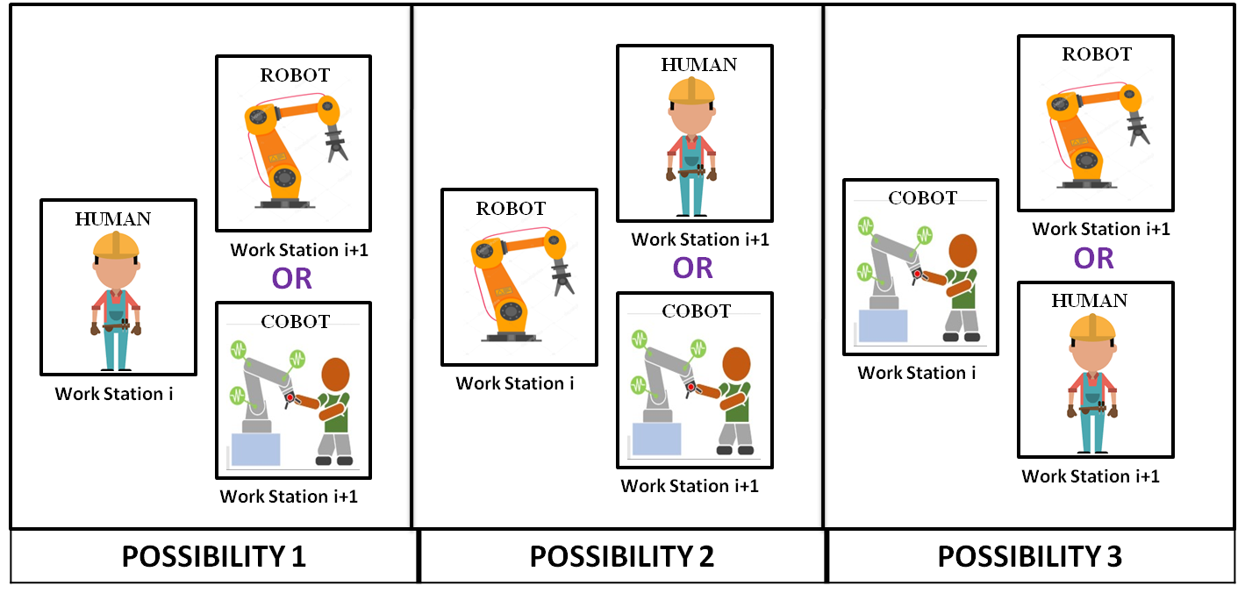

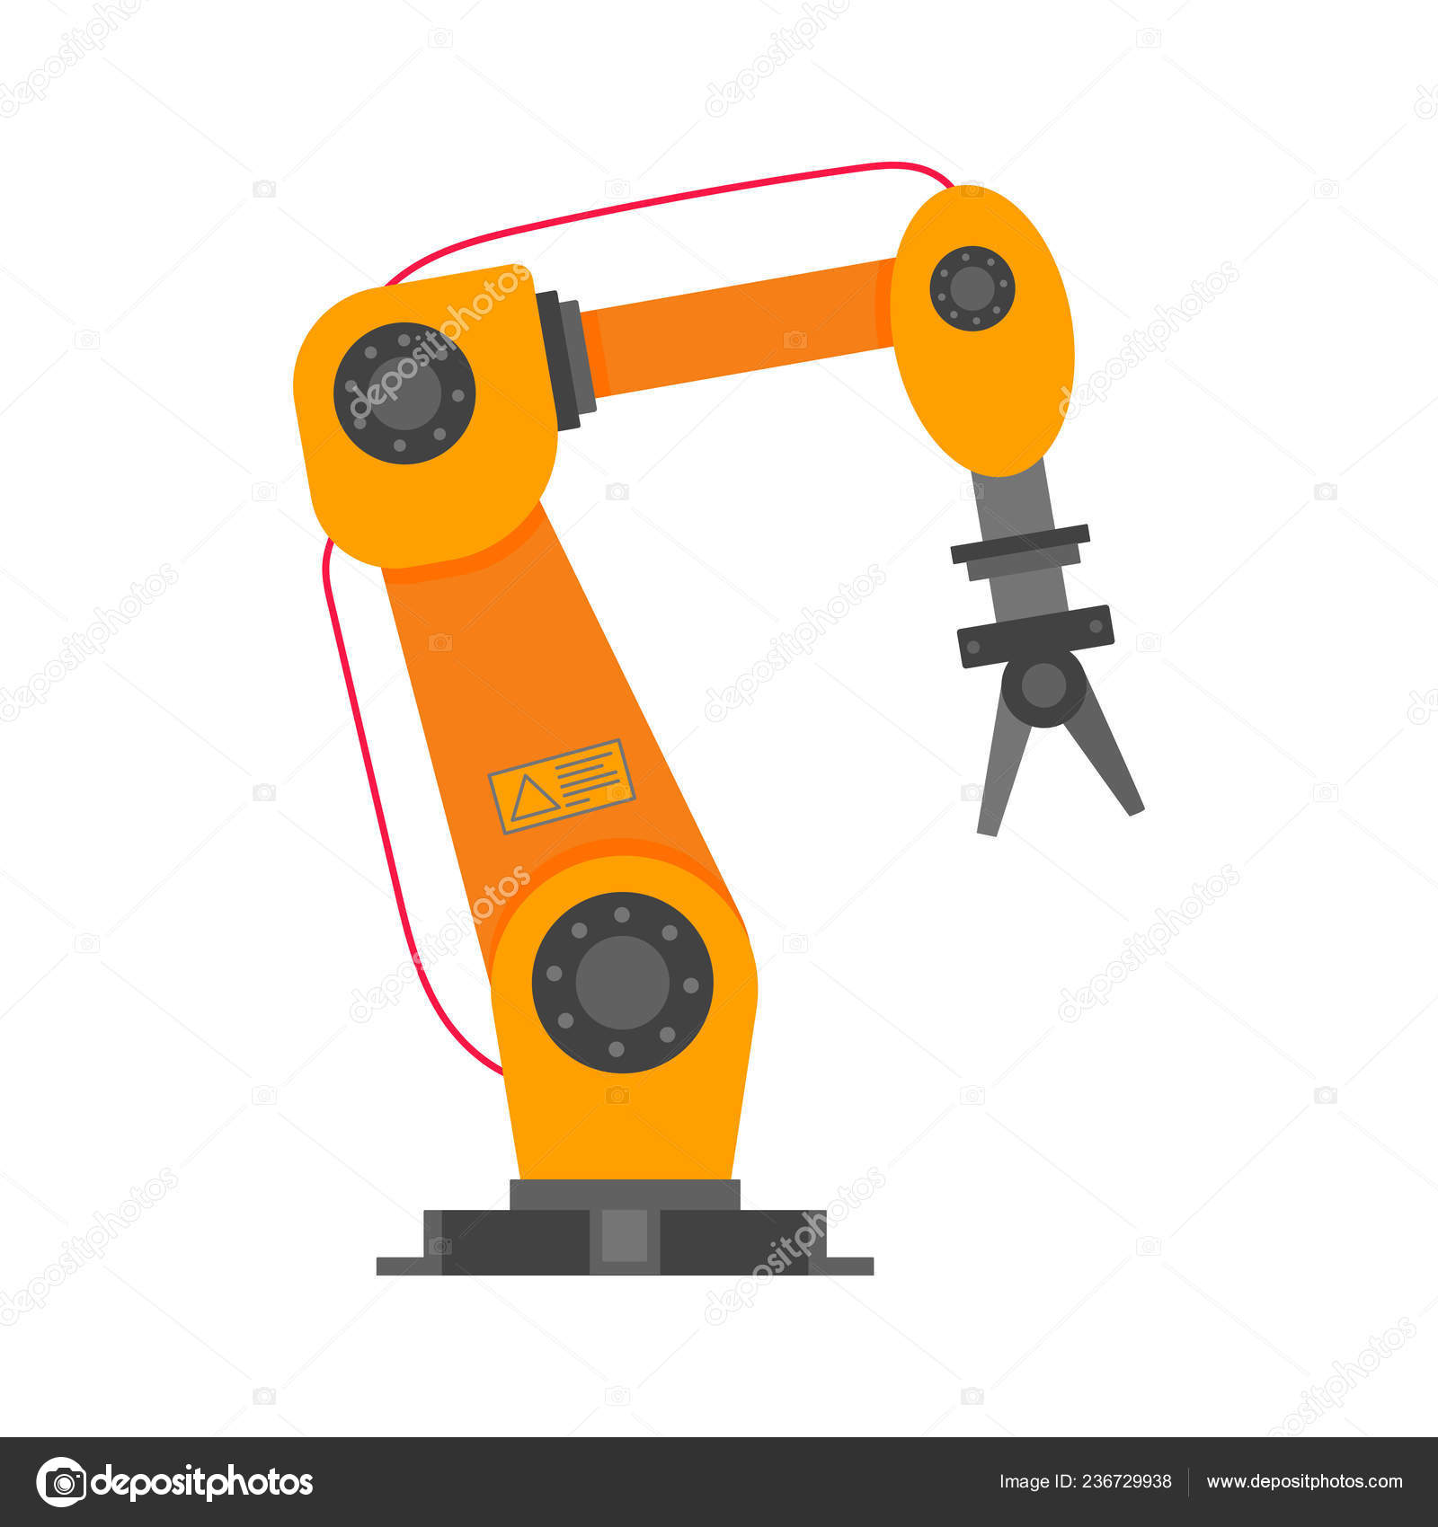
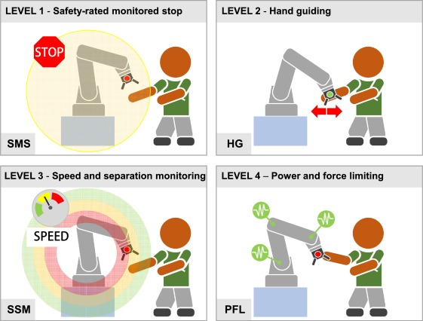
HUMAN ROBOT COLLABORATION IN ASSEMBLY LINE BALANCING
WORKSTATION CONSTRAINT is another such realistic model inculcated in line with other constraints. The constraint is such that “no two consecutive workstation shall have the same worker configuration”. This constraint adds to the practicality of limited automation investments in the line, as well as a spread in workforces, leveraging the flexibility and utter ability of humans to tackle problems at any point of the assembly line.

Slide 29
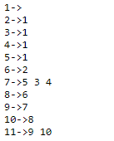
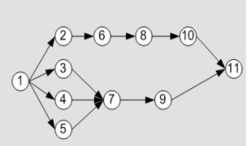
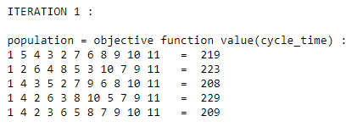
SEQUENCE GENERATION
For generating sequence, a precedence matrix is generally used in many papers.
But in our proposed method, we use adjacency list that stores the precedence relation efficiently and helps in generation of sequence that satisfied these relations.
The algorithm is as:
n = 0; number of tasks in generated sequence (initially no tasks are in the vector)
N; total number of tasks that are to be allocated
Create an empty vector - task sequence vector; holds the generated task sequence
Create an available set; consists of tasks that has no precedence
While (n <= N):
Pick a random task from the available set
Insert this task into the task sequence vector
Remove this task from the available set
Insert the tasks that had this removed task as its precedence
Increment n by 1
End While

Slide 30
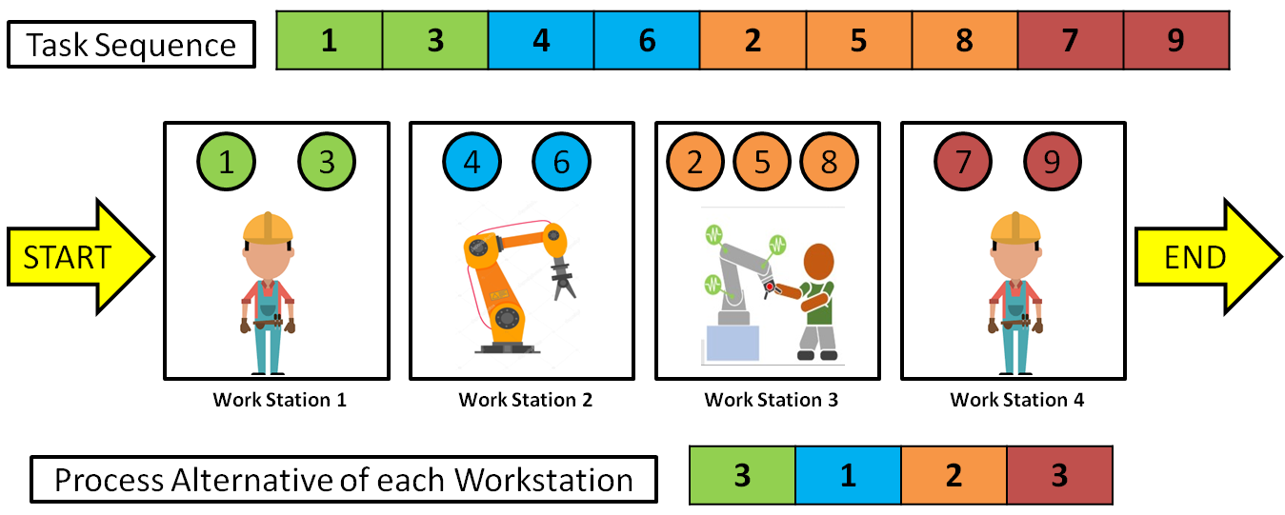
ENCODING TO OUR PROBLEM
→ A sequence of tasks (following precedence relation) is used to represent the order of tasks to be performed. Similarly, a sequence of process alternatives representing numbers between 1-3 for each station representing,
1 - Only robot is allocated
2 - COBOT (robot + human) is allocated
3 - Only human is allocated
For example, a 9 tasks, 4 stations encoding sequences looks like,
TASK PERMUTATION - 1 3 4 6 2 5 8 7 9
PROCESS ALTERNATIVES - 3 1 2 3

Slide 31
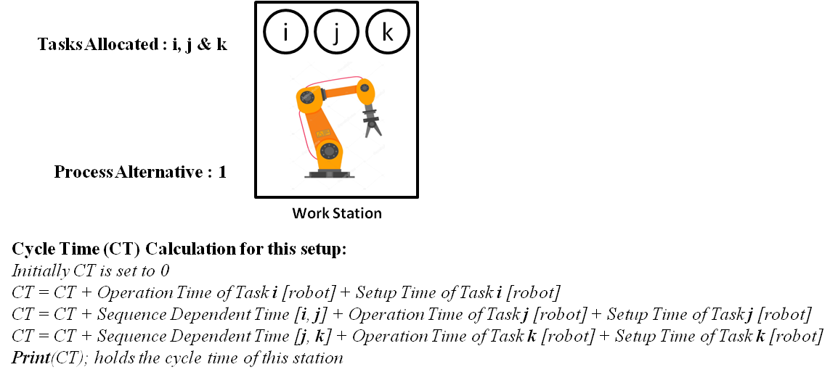
DECODING TO OUR PROBLEM
Cycle time evaluation for a workstation if a robot is allocated

Slide 32
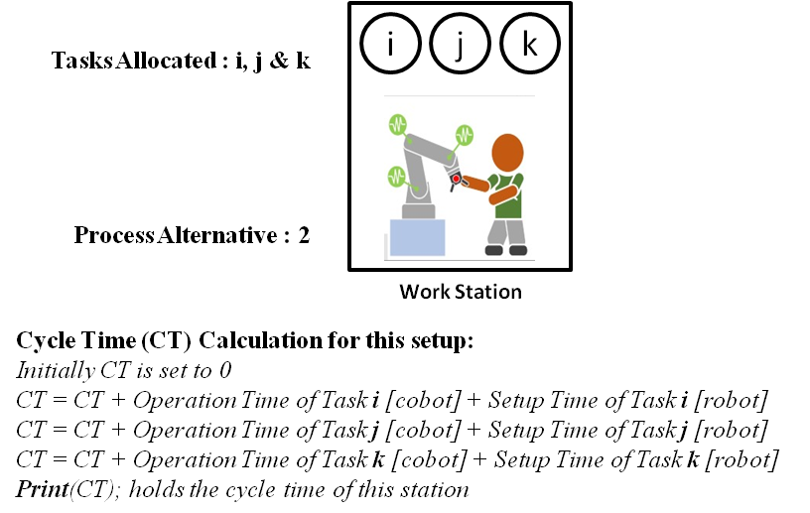
DECODING TO OUR PROBLEM
Cycle time evaluation for a workstation if a cobot is allocated

Slide 33
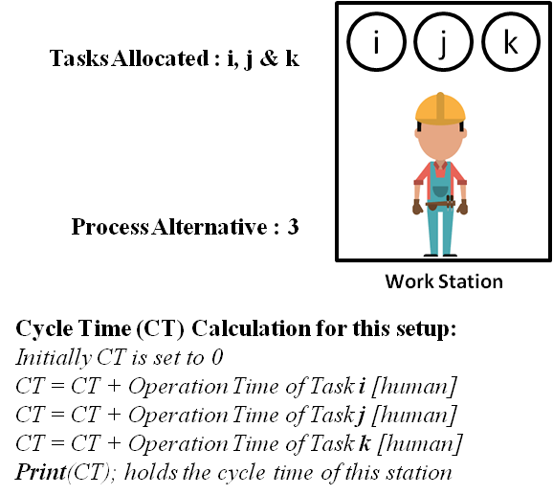
DECODING TO OUR PROBLEM
Cycle time evaluation for a workstation if a human is allocated

Slide 34
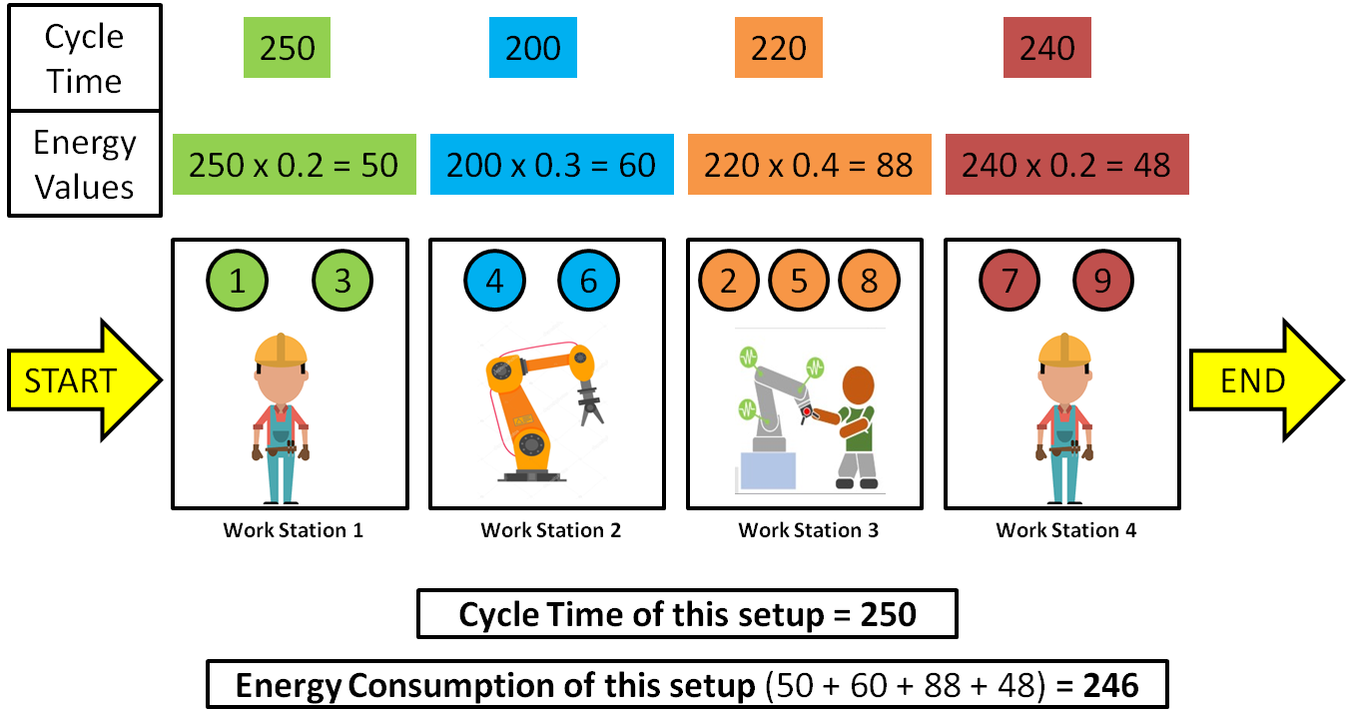
EXAMPLE OF ENCODING & DECODING

Slide 35

METAHEURISTIC ALGORITHMS

Slide 36
METAHEURISTIC ALGORITHMS
Very Flexible
Broad applicability
Robust to problem size, problem instance and random variables
Shorter computation time, useful for real time decision making
Ease of implementation
WHY METAHEURISTIC ALGORITHMS ?
Metaheuristics are strategies that guide the search process. The goal is to efficiently explore the search space in order to find near–optimal solutions.
Techniques which constitute metaheuristic algorithms range from simple local search procedures to complex learning processes.
Mimics real world examples
HOW METAHEURISTIC ALGORITHMS WORK ?

Slide 37
METAHEURISTIC ALGORITHMS
Start
Define Variables
Generate initial population
Evaluate objective functions
Store best solutions
Task sequence
Process alternative sequence
Cycle time
Energy consumption
External Archive
Update population using equations
Update best solutions
Evaluate objective functions
Using different algorithms &
Using Non dominated sorting
Termination criteria met?
End
YES
NO

Slide 38
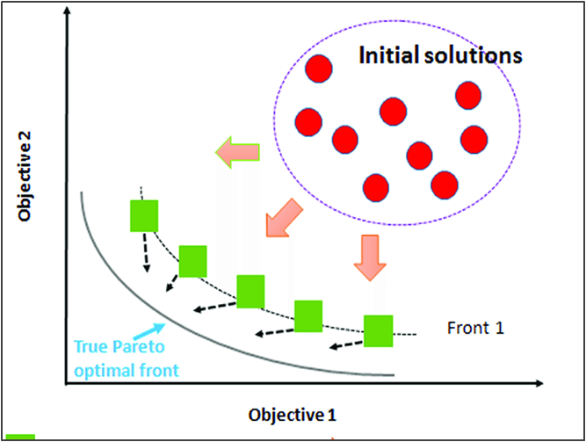
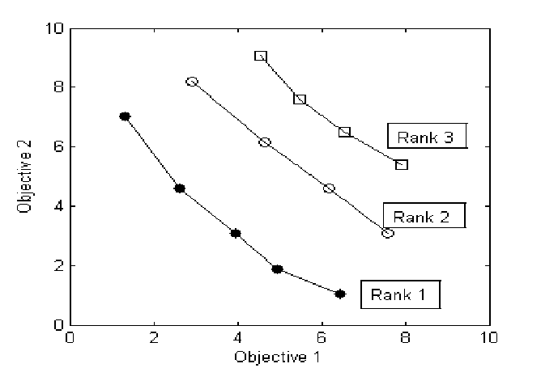
MULTI OBJECTIVE OPTIMISATION
Multi objective optimisation refers to solving multiple objectives that are conflicting in nature. As the objectives are conflicting, rather than a single optimal solution, a set of optimal solution is presented known as the pareto optimal set.
In non-dominated sorting, an individual A is said to dominate another individual B, if and only if there is no objective of A worse than objective of B.
In simple words, let us say there are two objectives f1 & f2 that is to be minimised, and two points A and B,
A dominates B if, f1(A) < f1(B) and f2(A) < f2(B)
Both lie in same front if, ( f1(A) < f1(B) and f2(A) > f2(B) ) or ( f1(A) > f1(B) and f2(A) < f2(B) )
B dominates A if, f1(A) > f1(B) and f2(A) > f2(B)
Some of the objectives in assembly line balancing problems are, To minimize the number of workstations, To minimize the cycle time, To minimize the energy consumption, To maximize the workload smoothness, etc..,

Slide 39
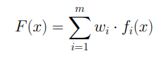
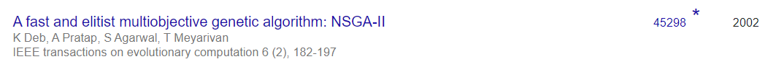
WHY NON-DOMINATED SORTING FOR MO HANDLING?
MOST COMMONLY USED METHODS TO HANDLE MULTI OBJECTIVE OPTIMISATION :-
WEIGHTED SUM METHOD - Construct a weighted sum of objectives and optimize. The difficulty with this method is that, the user must be well knowledged with the weights for each objectives as it influences the solution obtained.
CONSTRAINT METHOD - Minimize a primary objective while expressing all the other objectives in the form of inequality constraints. The difficulty with this method is that if the objectives are complex, expressing them into constraints is not effective in generating pareto optimal solutions.
NON DOMINATED SORTING WITH EXTERNAL ARCHIVE - This method as explained in the previous slide, generates many different solutions and stores them separately in an external archive.
MOST POPULARLY USED MULTI-OBJECTIVE HANDLING METHOD FOR MOST OPTIMISATION PROBLEMS:

Slide 40
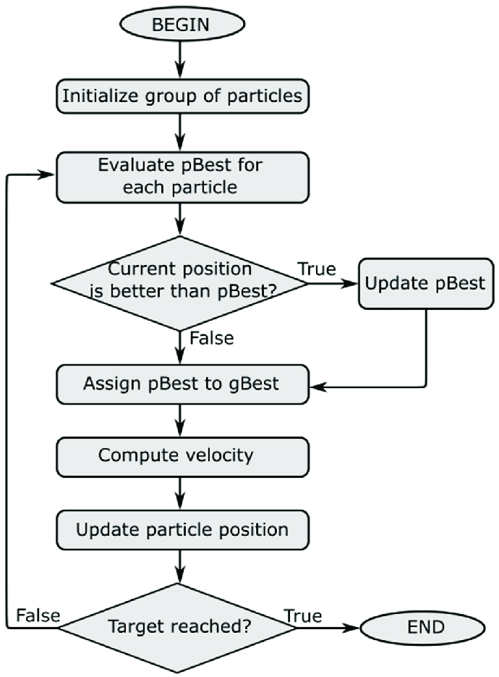
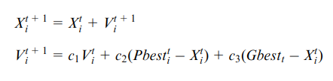
DISCRETE PARTICLE SWARM OPTIMISATION (PSO)
NOTATIONS USED:
t = indicates the iteration number
Xi = a single i’th solution in the population
Vi = a single i’th velocity vector in the population
P_best_i = indicates the best solution obtained by i’th particle so far
G_best = indicates the best solution obtained by the whole swarm so far
c1 = inertia weight
c2 = acceleration coefficient of P_best
c3 = acceleration coefficient of G_best

Slide 41
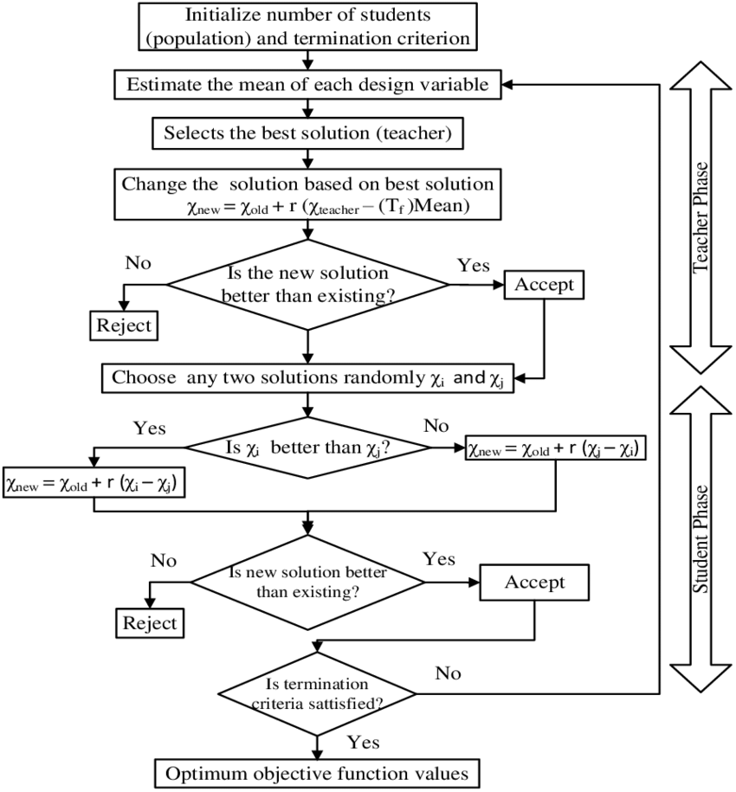
DISCRETE TEACHING LEARNING BASED OPTIMISATION (TLBO)
NOTATIONS USED:
X_i = a single i’th solution in the population.
r = Coefficient that indicates the impact of the mean of the population and the teacher
Tf = Teaching coefficient that indicates the impact of teacher
X_new = newly generated solution for the ith solution in the population
X_mean = mean of the population
X_best = teacher (best solution in the population)
X_partner = mean of the population

Slide 42
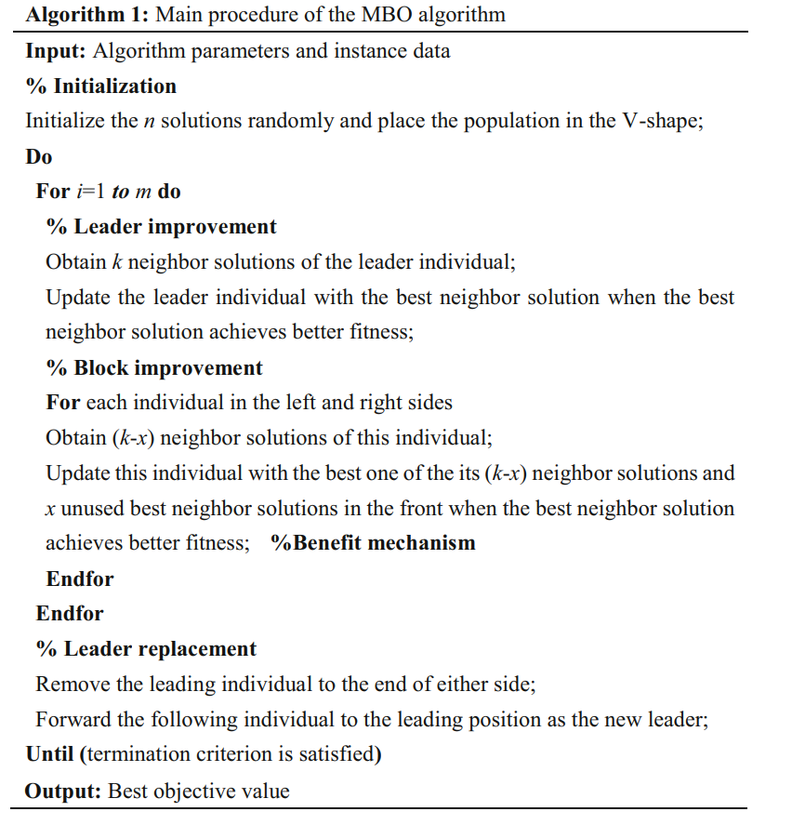

MIGRATING BIRD OPTIMISATION (MBO)

Slide 43
CHANGING THE TASK SEQUENCE PROCESS ALTERNATIVES
To change and find neighbor solutions of a particular solution,
First a random number ‘r’ is generated between (1 - n), where n = no. of tasks
Then the tasks in position (1 - r) are kept unchanged and the tasks from position (r+1 - n) are shuffled randomly such that precedence relation is followed. For example, (taking 11 tasks)
BEFORE CHANGING - 1 3 4 7 8 2 6 9 5 11 10
RANDOM NUMBER GENERATED ( r ) - 4
AFTER CHANGING - 1 3 4 7 6 9 8 2 5 10 11
To change and find neighbor solutions of a particular solution,
SWAPPING and SINGLE POINT MUTATION (randomly picking a position and changing its value) is performed such that the constraints are satisfying. For example for a 4 station problem,
BEFORE CHANGING - 1 3 1 2
AFTER PERFORMING SWAP - 1 3 2 1 (last two positions are swapped)
AFTER SINGLE POINT MUTATIONS - 2 3 2 1 (1st position is mutated)

Slide 44
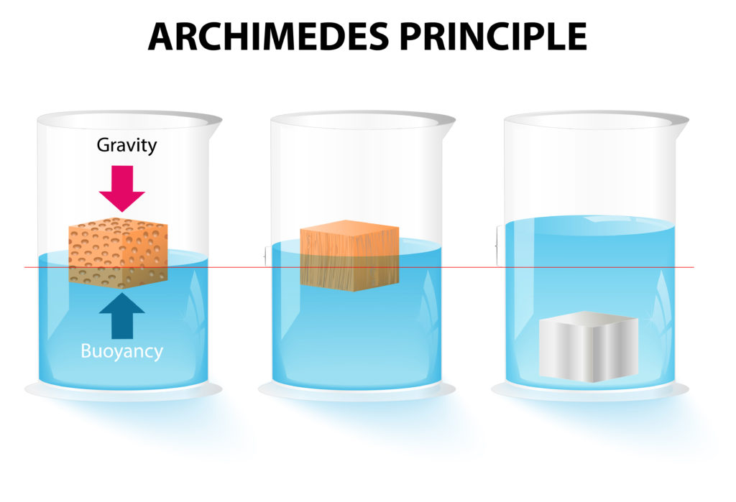
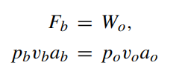
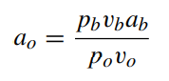
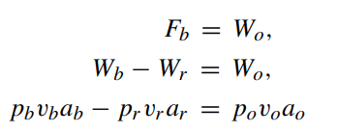
ARCHIMEDES OPTIMISATION ALGORITHM (AOA)
The AOA or Archimedes optimisation algorithm works on the basis of Archimedes principle, where buoyant force is exerted on objects partially immersed in water, to maintain their equilibrium.
Assuming multiple objects immersed in the same fluid, where the objects are analogous to each population member and the fluid media is the search space, each object(member) tries to reach equilibrium (optimised state), which is if the respective buoyant force Fb is equal to the their individual weights Wr.
MATHEMATICAL FORMULAE USED:
p → Density;
v → Volume;
a → acceleration due to gravity;
Subscripts: b for fluid and o for each immersed object.
}
The equilibrium state equation used when there is another force influenced on the object like collision with another neighbouring
object (r)

Slide 45
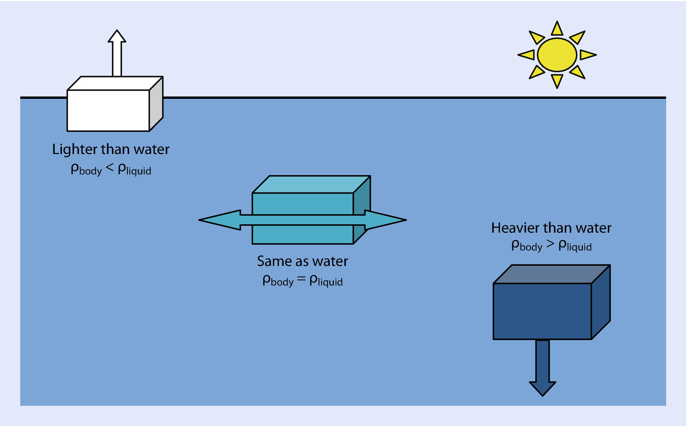
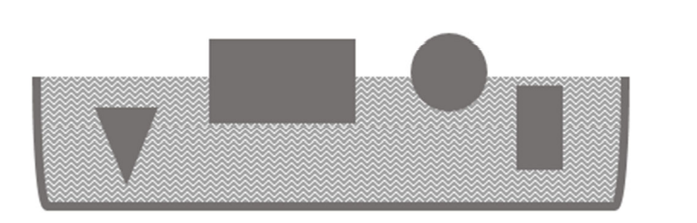
GENERAL FLOW OF AOA
Initialize a random population, velocity, density, volume, acceleration
For t=1 to T (termination criteria)
For i=1 to P (population size)
1. UPDATE density ([1 x P] array) and volume ([1 x P] array)
2. UPDATE TF (transfer operator) & d (density decreasing factor)
3. UPDATE acceleration ([1 x P] array)
4. NORMALISE acceleration
5. UPDATE POPULATION using the updated parameters
END
END

Slide 46
WORKING OF MODIFIED AOA
UPDATION OF DENSITY & VOLUME
2. UPDATION OF TF & d
→ Initial density and volume for each object of the population is generated randomly as a variable between [0-1]. Then for next iterations, the equations:
den(i)_t+1 = den(i)_t + r * (den_best - den(i)_t)
vol(i)_t+1 = vol(i)_t + r * (vol_best - vol(i)_t)
where,
den(i)_t → density of i’th object in t’th iteration
den_best → density of best object in that population
vol(i)_t → density of i’th object in t’th iteration
Vol_best → density of best object in that population
r → random number between (0-1)
→ The TF and d are the fine tuning parameters, which are calculated as the iteration progresses, rather than tuned by user.
This makes this algorithm to be more randomized and exploit the search space, without having any user-defined bias.
TF_t = exp ( ( t - t_max ) / t_max )
d_t = exp ( ( t_max - t ) / t_max ) ) - ( t / t_max)
where,
TF_t → transfer operator for t’th iteration
t_max → maximum number of iterations
d_t → density decreasing factor for t’th iteration

Slide 47
WORKING OF MODIFIED AOA
3. UPDATION OF ACCELERATION
4. NORMALISATION OF ACCELERATION
→ Initial acceleration for each object of the population is generated randomly as a variable between [0-1]. Then for next iterations, the equation:
acc_i = ( (den_r + vol_r * acc_r) / (den_i * vol_i ) IF TF <= 0.5
(exploration phase - when collision between object occurs)
acc_i = ( (den_best + vol_best * acc_best) / (den_i * vol_i ) TF > 0.5
(exploitation phase - when there is no collision between objects)
where,
acc_i → acceleration of i’th object
den_best → density of best object in that population
den_r → density of r’th object (‘r’ is generated randomly)
vol_best → volume of best object in that population
vol_r → volume of r’th object (‘r’ is generated randomly)
acc_best → acceleration of best object in that population
acc_r → acceleration of r’th object (‘r’ is generated randomly)
→ The updated acceleration of each object is then normalised as:
acc_i(norm) = (u * (acc_i - acc_min) / (acc_max - acc_min) ) ) + l
Where,
acc_i(norm) → normalised acceleration of i’th object
acc_i → acceleration of i’th object in that population
Acc_max → maximum acceleration in the population
acc_min → minimum acceleration in the population
u = 0.9 (range of normalisation)
l = 0.1 (range of normalisation)
The acc_i(norm) determines the percentage of step that each object will change.
If the object i is far away from global optimum, acceleration value will be high—meaning that the object will be in the exploration phase, otherwise, in exploitation phase.
This helps search agents move towards the global best solution and at the same time they move away from local solutions.

Slide 48
WORKING OF MODIFIED AOA
5. UPDATION OF POPULATION
IF TF<=0.5 - exploration phase equation is called (collision between objects)
x(i)_t+1 = x(i)_t + ( d * acc(i)_t+1 * ( x(r)_t - x(i)_t ) )
IF TF>0.5 - exploitation phase equation called (no collision)
x(i)_t+1 = x(i)_t + ( F * d * acc(i)_t+1 * ( x_best - x(i)_t ) )
where,
acc(i)_t → acceleration of i’th object in t’th iteration
x(i)_t → decision variable of i’th object in t’th iteration
x_best → best value of decision variable in the population
x(r)_t → decision variable of r’th object in t’th iteration where ‘r’ is generated randomly
d → density decreasing factor
F → Randomly generated, either -1 or +1

Slide 49
WHY AOA FOR OUR PROBLEM?
A recent algorithm(2020-2021) that has never been explored much. This algorithm has never been used in assembly line balancing problem which gives more value and novelty to our paper/project.
Has dedicated exploration and exploitation phases that creates a balance between exploration and exploitation.
Has no fine tuning parameters.
Any type of user with no knowledge of metaheuristic algorithms can use this algorithm and get results.
Faster compared to other algorithms as computations of simple math equations are faster.
Not much complexity involved in updation of population.
Larger search space is explored.
Easy to implement and hybridize with other algorithms.

Slide 50
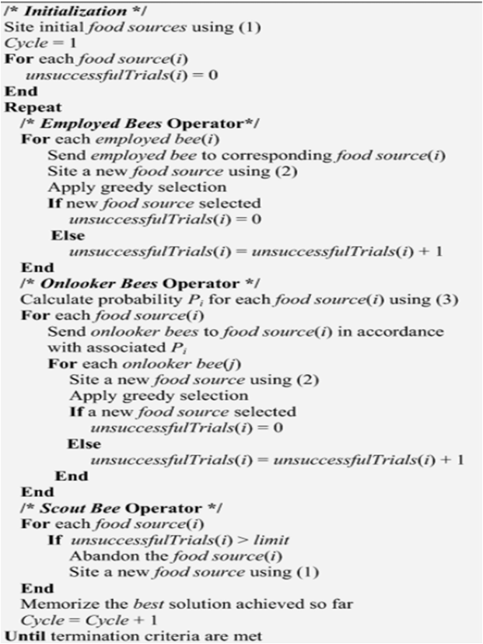
HYBRIDISATION OF ALGORITHMS
Variants for algorithms are created to make the algorithm give better results.
By hybridizing the algorithm with another combines the advantages of both the algorithm and gives better solution than a single algorithm.
The algorithm chosen to hybridize with the developed 4 algorithms is ABC (artificial bee colony algorithm).
The scout phase from this ABC algorithm is added with those 4 algorithms(PSO, TLBO, MBO, AOA).
The main reason of adding the scout phase is that, it increases the exploration and exploitation space and gives better pareto fronts by replacing the retained solutions and replacing it with a random one.
Easy to implement and hybridize with other algorithms.
All these algorithms are compared using those performance indicators. The best performing algorithm after testing those with different data sets is presented in next section.

Slide 51

DISCRETIZATION

Slide 52
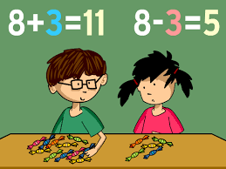
WHAT IS DISCRETIZATION
Addition, subtraction & multiplication of continuous variables is easy…….
BUT HOW TO DO THE SAME FOR TASK AND PROCESS ALTERNATIVE SEQUENCES ???

Slide 53
ADDITION OF TWO SEQUENCES
ALGORITHM
1 | 3 | 4 | 2 | 5
X1; task sequence 1
X2; task sequence 2
Y; vector to hold the answer after carrying out the operation
For i in range(1, Number of tasks):
If(X1[i] == X2[i]):
assign X1[i] to Y[i]
Else if(X1[i] > X2[i]):
assign X1[i] to Y[i]
Else:
assign X2[i] to Y[i]
End if
End for
1 | 2 | 4 | 3 | 5
1
3
4
3
5

Slide 54
SUBTRACTION OF TWO SEQUENCES
ALGORITHM
1 | 3 | 4 | 2 | 5
X1; velocity vector
X2; task sequence vector
Y; vector to hold the answer after carrying out the operation
For i in range(1, Number of tasks):
If(X1[i] == X2[i]):
assign 0 to Y[i]
Else if(X1[i] < X2[i]):
assign X1[i] to Y[i]
Else:
assign X2[i] to Y[i]
End if
End for
1 | 2 | 4 | 3 | 5
0
2
0
2
0

Slide 55
MULTIPLICATION OF A SEQUENCE WITH CO-EFF
ALGORITHM
1 | 3 | 4 | 2 | 5
X; task sequence
C; co-efficient
Y; vector to hold the answer after carrying out the operation
For i in range(1, Number of tasks):
R; generate random number between (0 to 1)
If(R <= C):
assign X1[i] to Y[i]
Else:
assign 0 to Y[i]
End if
End for
0.7 | 0.7 | 0.7 | 0.7 | 0.7
0.1
0.8
0.9
0.4
0.7
0
3
4
0
5

Slide 56
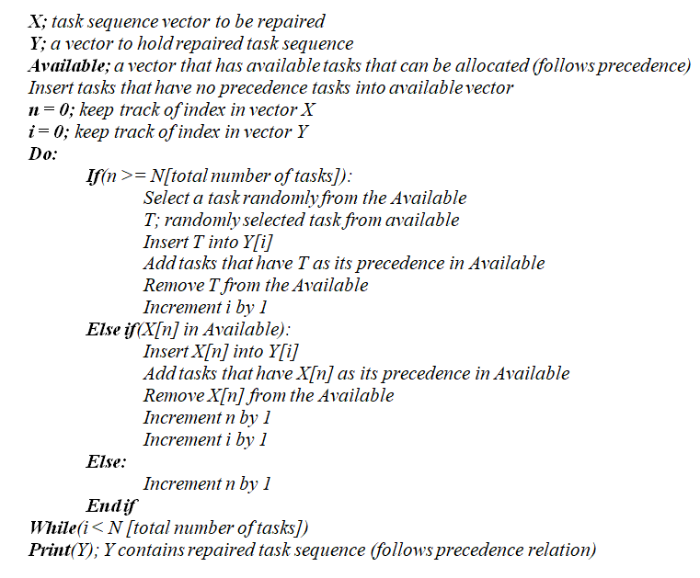
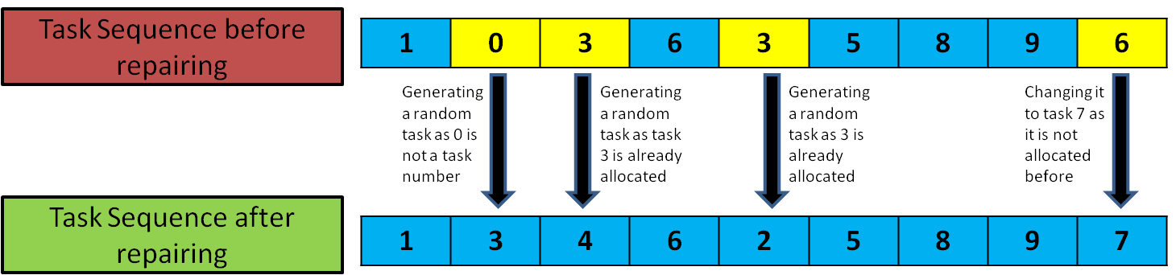
REPAIR FUNCTION
ALGORITHM
HOW IS THE SEQUENCES FEASIBLE AFTER GETTING UPDATED USING THE EQUATIONS???

Slide 57
6. RESULTS & DISCUSSION

Slide 58
PROPOSED 32 STANDARD TESTING HRC DATASETS
DATA SET no. | No. of Tasks | No. of stations | DATA SET no. | No. of Tasks | No. of stations
1 | 25 | 3 | 12 | 53 | 14
2 | 25 | 4 | 13 | 70 | 7
3 | 25 | 6 | 14 | 70 | 10
4 | 25 | 9 | 15 | 70 | 14
5 | 35 | 4 | 16 | 70 | 19
6 | 35 | 5 | 17 | 89 | 8
7 | 35 | 7 | 18 | 89 | 12
8 | 35 | 12 | 19 | 89 | 16
9 | 53 | 5 | 20 | 89 | 21
10 | 53 | 7 | 21 | 111 | 9
11 | 53 | 10 | 22 | 111 | 13
DATA SET no. | No. of Tasks | No. of stations
E
X
P
E
R
I
M
E
N
T
A
L
S
E
T
T
I
N
G
23 | 111 | 17
24 | 111 | 22
25 | 148 | 10
26 | 148 | 14
27 | 148 | 21
28 | 148 | 29
29 | 297 | 19
30 | 297 | 29
31 | 297 | 38
32 | 297 | 50

Slide 59
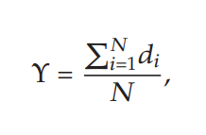
PERFORMANCE INDICATORS
PI 1 - NUMBER OF NON DOMINATED SOLUTIONS FOUND
The number of non-dominated solution generated by each algorithm in Pareto solution.
Higher PI 1 shows better algorithm performance.
PI 2 - ERROR RATIO
The number of solution which is not member of the Pareto
optimal set divided by the number of solution generated by the algorithm.
Smaller PI 2 shows better algorithm performance.
PI 3 - CONVERGENCE METRIC
This metric measures the extent of convergence to a known set of Pareto optimal solutions, as follows:
where, N is the number of nondominated solutions obtained with an algorithm and,
di is the Euclidean distance between each of the nondominated solutions and the nearest member of the true Pareto optimal front.

Slide 60
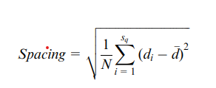
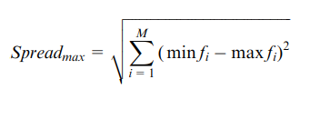

PERFORMANCE INDICATORS
PI 4 - SPACING
This indicator measures the relative distance between each solution.
where, di is the distance between solution i and the nearest solution, while d is the average of all di.
The smaller spacing index shows better solution and has better space between each solution.
PI 5 - MAXIMUM SPREAD
The spread of solution found by each algorithm.
Larger maximum spread is better.
PERFORMANCE INDICATOR | PI 1 | PI 2 | PI 3 | PI 4 | PI 5
BETTER PERFORMANCE

Slide 61
PROPOSED PARAMETER FINE TUNING METHODS
ALGORITHM | RANGES
PSO (c1-inertia weight c2-acceleration coefficient of P_best c3-acceleration coefficient of G_best) | Range 1 : c1 ∈ (0, 0.5), c2+c3 <= 1.5 Range 2 : c1 ∈ (0.5, 1), c2+c3 <= 1.5 Range 3 : c2 ∈ (0, 0.5), c1+c3 <= 1.5 Range 4 : c2 ∈ (0.5, 1), c1+c3 <= 1.5 Range 5 : c3 ∈ (0, 0.5), c1+c2 <= 1.5 Range 6 : c3 ∈ (0.5, 1), c1+c2 <= 1.5
TLBO (r-mean impact coefficient Tf-Teaching coefficient Tp-Learning coefficient) | Range 1 : r ∈ (0, 0.5), Tf+Tp <= 1.5 Range 2 : r ∈ (0.5, 1), Tf+Tp <= 1.5 Range 3 : Tf ∈ (0, 0.5), r+Tp <= 1.5 Range 4 : Tf ∈ (0.5, 1), r+Tp <= 1.5 Range 5 : Tp ∈ (0, 0.5), r+Tf <= 1.5 Range 6 : Tp ∈ (0.5, 1), r+Tf <= 1.5
ALGORITHM | RANGES
MBO (K - number of neighborhood solutions of current leader X - represents any number less than K) | Range 1 : K=2, X=1 Range 2 : K=3, X=1 Range 3 : K=5, X=2 Range 4 : K=5, X=3 Range 5 : K=7, X=3 Range 6 : K=10, X=5
AOA | No fine tuning needed as parameters are neglected for the developed & improved AOA.
Method devised based on the position & role of each parameter in their respective UPDATE EQUATIONS.

Slide 62
CONSOLIDATED PARAMETER FINE TUNING RESULTS
Ideal sets of parametric value ranges for fine tuning of all the developed algorithms found using the Performance Indicators on the generated 32 standard testing HRC datasets.
These ideal fine-tuning ranges are categorized based on the task size of any problem.
ALGORITHM | PSO | TLBO | MBO | AOA
SMALL (task size < 50) | c1 = [0 - 0.5] c2 + c3 <= 1.5 | Tf = [0 - 0.5] r + Tp <= 1.5 | K = 5 X = 3 | -------
MEDIUM (50 < task size < 100) | c3 = [0.5 - 1] c1 + c2 <= 1.5 | Tp = [0.5 - 1] r + Tf <= 1.5 | K = 3 X = 1 | -------
LARGE (task size > 100) | c2 = [0.5 - 1] c1 + c3 <= 1.5 | Tf = [0 - 0.5] r + Tp <= 1.5 | K = 5 X = 2 | -------

Slide 63
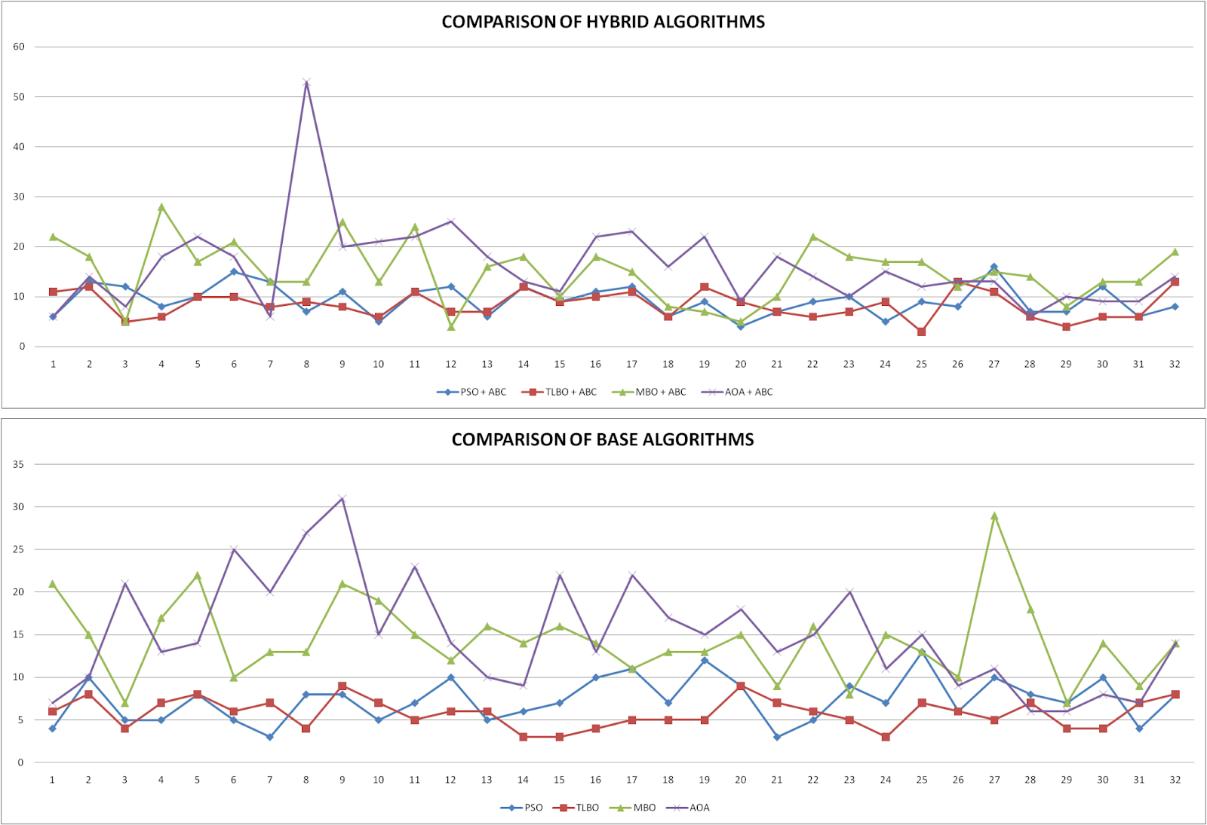
RESULTS USING PERFORMANCE INDICATOR PLOTS
PERFORMANCE INDICATOR 1:
Non-dominated solutions count (N)

Slide 64
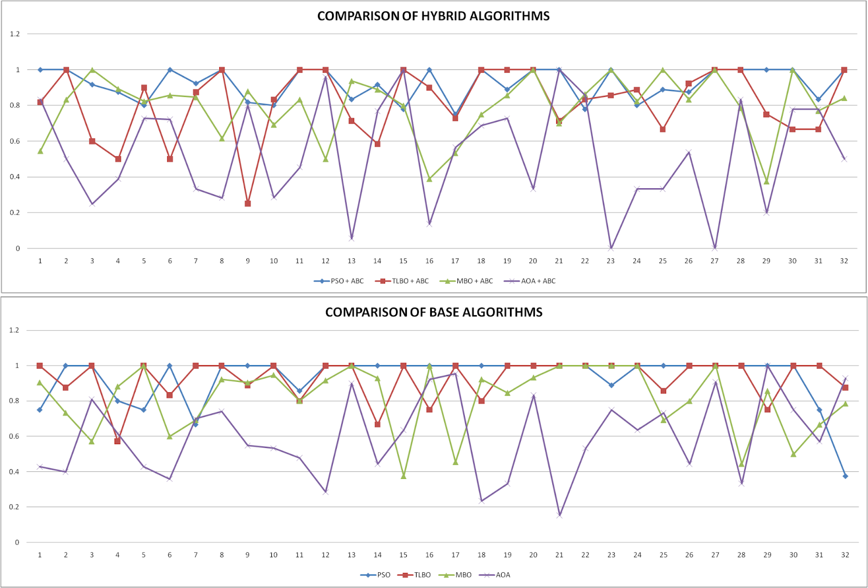
RESULTS USING PERFORMANCE INDICATOR PLOTS
PERFORMANCE INDICATOR 2:
Global Error Ratio
(E_{G})

Slide 65
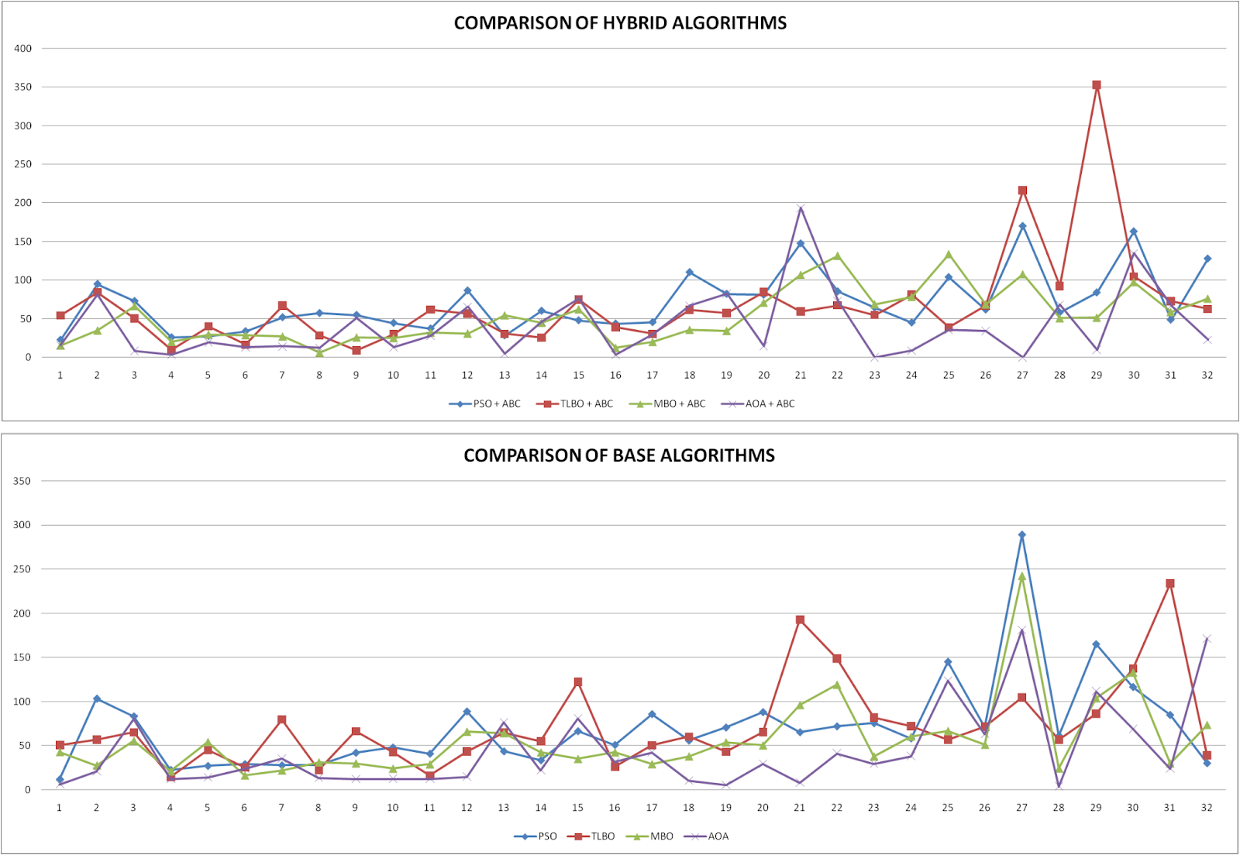
RESULTS USING PERFORMANCE INDICATOR PLOTS
PERFORMANCE INDICATOR 3:
Convergence Metric (CM)
Regions of less spread & hence less significance

Slide 66


COMPARATIVE RESULTS USING STATISTICAL ANALYSIS
Friedman Test results for the developed algorithms
If the value of p statistic is lesser than 0.05, there lies significance between developed algorithms for the indicated performance function.
PERFORMANCE INDICATOR | Number of data sets (n) | Chi-square value (χ2) | Degrees of freedom (df) | p- value (significance indicator)
Non dominated solutions count (N) | 32 | 61.434 | 3 | < 0.00001
Global error ration (E_{G}) | 32 | 29.025 | 3 | 0.00028
Convergence metric (CM) | 32 | 23.888 | 3 | 0.287
Friedman Test results for standard algorithms
PERFORMANCE INDICATOR | Number of data sets (n) | Chi-square value (χ2) | Degrees of freedom (df) | p- value (significance indicator)
Non dominated solutions count (N) | 32 | 39.722 | 3 | < 0.00001
Global error ration (E_{G}) | 32 | 18.35 | 3 | 0.00037
Convergence metric (CM) | 32 | 18.488 | 3 | 0.343
Friedman Test results for hybridized algorithms

Slide 67
COMPARATIVE RESULTS USING STATISTICAL ANALYSIS
(POST-HOC TESTS) Scheffé multiple comparison test results using Non-dominated solutions count(N):
Treatments pair | Scheffé T-statistic | Scheffé p-value | Scheffé inference
PSO vs PSO+ABC | 1.5206 | 0.9397136 | insignificant
PSO vs TLBO | 1.2215 | 0.9822245 | insignificant
PSO vs TLBO+ABC | 0.8725 | 0.9977599 | insignificant
PSO vs MBO | 5.5839 | 0.0001095 | ** p<0.01
PSO vs MBO+ABC | 6.0575 | 1.3529e-05 | ** p<0.01
PSO vs AOA | 6.1323 | 9.5683e-06 | ** p<0.01
PSO vs AOA+ABC | 6.8552 | 2.7179e-07 | ** p<0.01
PSO+ABC vs TLBO | 2.7421 | 0.3805235 | insignificant
PSO+ABC vs TLBO+ABC | 0.6481 | 0.9996801 | insignificant
PSO+ABC vs MBO | 4.0633 | 0.0238375 | * p<0.05
INFERENCE:
Both the developed standard & hybridized AOA algorithm shows better significance consistently when compared with most algorithms.
However, the MBO algorithm shows less significance when compared to the AOA algorithm (evident from plots), indicating that these two algorithms yield the most number of non-dominated solutions
(front 1 solutions)

Slide 68
COMPARATIVE RESULTS USING STATISTICAL ANALYSIS
Treatments pair | Scheffé T-statistic | Scheffé p-value | Scheffé inference
Treatments pair | Scheffé T-statistic | Scheffé p-value | Scheffé inference
PSO+ABC vs MBO+ABC | 4.5369 | 0.0056326 | ** p<0.01
PSO+ABC vs AOA | 4.6117 | 0.0043954 | ** p<0.01
PSO+ABC vs AOA+ABC | 5.3346 | 0.0003057 | ** p<0.01
TLBO vs TLBO+ABC | 2.0939 | 0.7339294 | insignificant
TLBO vs MBO | 6.8053 | 3.5161e-07 | ** p<0.01
TLBO vs MBO+ABC | 7.2790 | 2.8504e-08 | ** p<0.01
TLBO vs AOA | 7.3537 | 1.8919e-08 | ** p<0.01
TLBO vs AOA+ABC | 8.0766 | 3.0302e-10 | ** p<0.01
TLBO+ABC vs MBO | 4.7114 | 0.0031316 | ** p<0.01
TLBO+ABC vs MBO+ABC | 5.1850 | 0.0005516 | ** p<0.01
TLBO+ABC vs AOA | 5.2598 | 0.0004116 | ** p<0.01
TLBO+ABC vs AOA+ABC | 5.9827 | 1.9047e-05 | ** p<0.01
MBO vs MBO+ABC | 0.4736 | 0.9999615 | insignificant
MBO vs AOA | 0.5484 | 0.9998958 | insignificant
MBO vs AOA+ABC | 1.2713 | 0.9775765 | insignificant
MBO+ABC vs AOA | 0.0748 | 1.0000000 | insignificant
MBO+ABC vs AOA+ABC | 0.7977 | 0.9987435 | insignificant
AOA vs AOA+ABC | 0.7229 | 0.9993403 | insignificant

Slide 69
COMPARATIVE RESULTS USING STATISTICAL ANALYSIS
(POST-HOC TESTS) Scheffé multiple comparison test results using Global Error Ratio (E_{G})
Treatments pair | Scheffé T-statistic | Scheffé p-value | Scheffé inference
PSO vs PSO+ABC | 0.2398 | 0.9999996 | insignificant
PSO vs TLBO | 0.1123 | 1.0000000 | insignificant
PSO vs TLBO+ABC | 2.4252 | 0.5548421 | insignificant
PSO vs MBO | 2.4807 | 0.5235409 | insignificant
PSO vs MBO+ABC | 2.8873 | 0.3084131 | insignificant
PSO vs AOA | 6.9436 | 1.7142e-07 | ** p<0.01
PSO vs AOA+ABC | 8.5068 | 2.2587e-11 | ** p<0.01
PSO+ABC vs TLBO | 0.1275 | 1.0000000 | insignificant
PSO+ABC vs TLBO+ABC | 2.1854 | 0.6870097 | insignificant
PSO+ABC vs MBO | 2.2409 | 0.6573650 | insignificant
Treatments pair | Scheffé T-statistic | Scheffé p-value | Scheffé inference
PSO+ABC vs MBO+ABC | 2.6475 | 0.4308202 | insignificant
PSO+ABC vs AOA | 6.7038 | 5.9074e-07 | ** p<0.01
PSO+ABC vs AOA+ABC | 8.2670 | 9.7203e-11 | ** p<0.01
TLBO vs TLBO+ABC | 2.3130 | 0.6178117 | insignificant
TLBO vs MBO | 2.3684 | 0.5868431 | insignificant
TLBO vs MBO+ABC | 2.7750 | 0.3635503 | insignificant
TLBO vs AOA | 6.8314 | 3.0742e-07 | ** p<0.01
TLBO vs AOA+ABC | 8.3945 | 4.4892e-11 | ** p<0.01
TLBO+ABC vs MBO | 0.0554 | 1.0000000 | insignificant

Slide 70
COMPARATIVE RESULTS USING STATISTICAL ANALYSIS
Treatments pair | Scheffé T-statistic | Scheffé p-value | Scheffé inference
INFERENCE:
Again, both the developed standard & hybridized AOA algorithm shows better significance consistently when compared with most algorithms.
However for error ratio, there lies significance in the performance of AOA even when compared with the MBO algorithm.
TLBO+ABC vs MBO+ABC | 0.4621 | 0.9999675 | insignificant
TLBO+ABC vs AOA | 4.5184 | 0.0059837 | ** p<0.01
TLBO+ABC vs AOA+ABC | 6.0815 | 1.2109e-05 | ** p<0.01
MBO vs MBO+ABC | 0.4066 | 0.9999865 | insignificant
MBO vs AOA | 4.4629 | 0.0071595 | ** p<0.01
MBO vs AOA+ABC | 6.0261 | 1.5628e-05 | ** p<0.01
MBO+ABC vs AOA | 4.0563 | 0.0243050 | * p<0.05
MBO+ABC vs AOA+ABC | 5.6194 | 9.4186e-05 | ** p<0.01
AOA vs AOA+ABC | 1.5631 | 0.9303866 | insignificant
CONCLUSION:
This concludes that the recently introduced AOA algorithm performs far superior compared to the existing popular metaheuristic algorithms in the line balancing domain (never used before!)
This project has hence successfully developed a discretized Hybrid AOA algorithm and applied it to enhance optimization of HRC assembly line balancing.

Slide 71
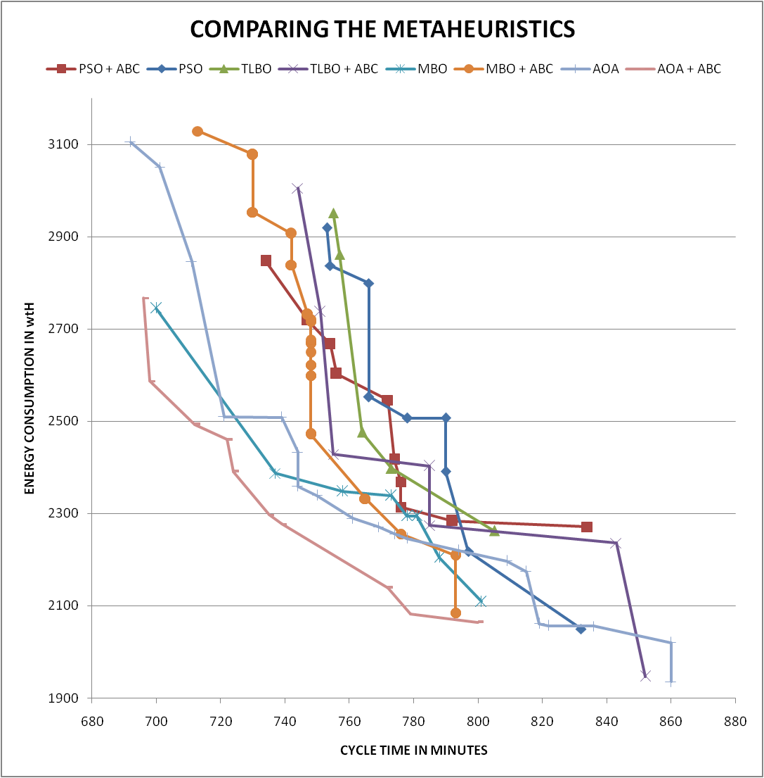
COMPARISON OF PARETO OPTIMAL FRONTS
In addition to the performance indicator (N) that shows the count of pareto optimal solutions, the coordinate positions of the pareto optimal front are also assessed, to analyse the best algorithmic performance in yielding the most optimal solutions.
Compared to every other algorithm, the pareto front of AOA algorithm is the closest to the origin and hence tends to yield the most optimized solutions with minimized objectives.
Compared to every other algorithm, the pareto front of the hybridized AOA algorithm has a large pareto front and hence shows increased exploration of optimal solutions. Thus, the hybridization method developed in this project strikes a balance between exploration & exploitation capabilities.

Slide 72
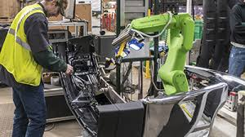
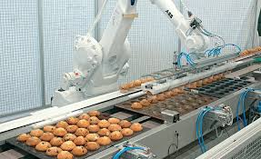

HRCAL vs RAL
Even though robots perform better than humans, using more number of robots in the assembly line increases the energy consumption & investment cost.
To justify this statement, the algorithms were modified to produce results for fully automated (only robotic assembly line) assembly line and compared with the results produced for human robot collaborative assembly line.
Less investment
Combines advantage of both human and robots
Has less energy consumption compared to RAL
Flexible assembly line
Huge investment
Fully automated assembly line
Not as flexible as HRCAL
Has better cycle time compared to HRCAL

Slide 73
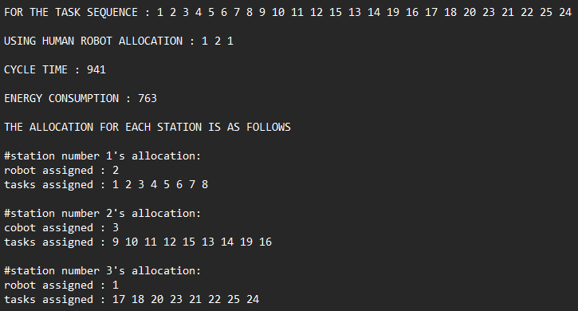
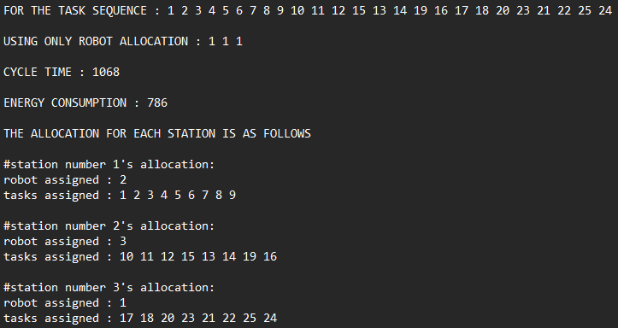
RESULTS OF HRCAL vs RAL
Task allocation of same sequence using HRCAL & RAL
1 - Only robot allocated to the workstation
2 - Cobot (robot + human) allocated to the workstation
3 - Only human allocated to the workstation
Number of tasks = 25
Number of workstations = 3

Slide 74
DATA USED FOR HRCAL vs RAL
DATA SET no. | No. of | No. of workstations
 | tasks
1 | 25 | 3
2 | 25 | 4
3 | 25 | 6
4 | 25 | 9
5 | 35 | 4
6 | 35 | 5
7 | 35 | 7
8 | 35 | 12
DATA SET no. | No. of | No. of workstations
 | tasks
9 | 53 | 5
10 | 53 | 7
11 | 53 | 10
12 | 53 | 14
13 | 70 | 7
14 | 70 | 10
15 | 70 | 14
16 | 70 | 19
DATA SET no. | No. of | No. of workstations
 | tasks
17 | 89 | 8
18 | 89 | 12
19 | 89 | 16
20 | 89 | 21
21 | 111 | 9
22 | 111 | 13
23 | 111 | 17
24 | 111 | 22

Slide 75

RESULTS OF HRCAL vs RAL
For all the different 24 data sets, the cycle time obtained for HRCAL & RAL are plotted as a bar graph as shown below.
We can see using HRCAL we can obtain same efficiency as fully automated assembly lines.
The difference in cycle time for a HRCAL & RAL is less.

Slide 76

RESULTS OF HRCAL vs RAL
For all the different 24 data sets, the energy consumption obtained for HRCAL & RAL are plotted as a bar graph as shown below.
We can see using HRCAL we can obtain better & energy efficient assembly line compared to fully automated assembly lines.
The difference in energy consumption for a HRCAL & RAL increases as the data size increases.

Slide 77

RESULTS OF HRCAL vs RAL
From the 24 data sets, the results obtained were interpreted in the form of robot contribution and cost reduction.
The bar graph shows that by using HRCAL rather than RAL, the cost is reduced without much compromise in the performance of the assembly line.

Slide 78

RESULTS OF HRCAL vs RAL
Ideal number of human % in assembly line for better results

Slide 79
7. CASE STUDY

Slide 80

ABOUT THE COMPANY
Sanmina Corporation is one of the leading electronics manufacturing service providers globally with a supply chain network around 28 countries.
Involved in the assembly of outsourced PCB components for various large scale energy projects.
With the motto “QUALITY IS OUR OXYGEN”, the infrastructure is of complete clean room technology with a semi-automated environment and advanced assembly automation systems.
The plant is located in Oragadam industrial Area as a part of the SEZ (Special economic Zone)
Since the assembly infrastructure is of a semi-automated environment i.e., has both humans and collaborative robots, the study of line balancing with human-robot collaboration would prove ideal.
The study can be conducted more flexibly and selectively as the company runs more than 20+ assembly lines to assemble their various products.

Slide 81

PROBLEM DESCRIPTION
With reference to the set of algorithms developed for this study along with the different data generation and resource constraints considered,
This case study aims to test and validate the performance of our developed metaheuristic algorithms by considering a suitable sub-assembly process. [DTDC HOUSING ASSEMBLY]
All tasks in the considered sub-assembly process is currently carried out manually, with human workers carrying out 90% of it.
The manual sub-assembly process is semi-automated by considering managerial cost and resource implications.
The automation to be introduced are studied of their specifications and suitability in assembling sensitive electronic components.
The workstation count is subjected to shop-floor space availability and is considered to be from 2 to 5.
The sub-assembly consists of a total of 23 tasks, which need to be optimally allocated among the workstations and assigned either manual/given collaborative robot resources with the aim to balance the line by reducing total cycle time & line energy consumption.

Slide 82
METHODOLOGY
After critical study and observation of all the assembly processes, a manual sub-assembly process was chosen for the purpose of case-study implementation.
The primary objective of the study was to semi-automate in the existing manual sub-assembly. Secondary objective was to use the developed multi-objective metaheuristic algorithms to validate their working and performance in allocating the tasks and resources optimally.
First, the number of tasks and a short process description is formulated.
Then, the operational times (& method examination) of each task being carried out manually is recorded.
A precedence constraint matrix is tabulated.
Then, after discussion with the line automation team of the industry, the robots and their types of end-effectors that can be employed to handle the several tasks are discussed. Their economic availability & specifications in terms of energy rating and safety factors are noted.
The task constraint table is finally formulated.
The workstation count possibilities are decided depending on shop floor space.

Slide 83

INPUT VALUES GENERATED
PRECEDENCE MATRIX (1 - precedes task ; 0 - doesn’t precede task )

Slide 84


INPUT VALUES GENERATED
OPERATION TIMES (secs)
RESOURCE ENERGY CONSUMPTION (Wh/s)

Slide 85

COMPARATIVE INSIGHTS
From the input data, a comparison between manual (existing) and HRC line balancing results for change in both cycle time & energy are plotted for a possible number of workstations.
The workstation count is then decided according to the best improvement in both cycle time & energy reduction.
A 3 workstation configuration shows the best reduction in both cycle time & energy (conflicting multi-objectives)
}
}

Slide 86


OPTIMAL ALLOCATION RESULTS
For a 3 workstation configuration, the best & optimal multi-objective HRC assembly line allocation determined by the standard & hybridized AOA algorithms are illustrated as shown.
Assembly line allocation that is currently being carried out in the industry to assemble the DTDT BOX ASSEMBLY UNIT.

Slide 87
8. CONCLUSIVE NOTE

Slide 88
9. MILESTONES

Slide 89


Milestone

Slide 90


Coding the consecutive method to evaluate objective functions (cycle time and energy consumption).
Implementing the multi objective handling using modified fast and elitist non dominated sorting technique.
Coding the algorithms, PSO, TLBO, MBO & AOA.
Carried out extensive literature review for assembly line balancing, robotic assembly line specifications, and all of the implemented algorithms.
Parallel contribution towards deciding efficient task, resource, safety, ergonomics and layout constraints in the assembly line.
Implementing the hybrid version of all above 4 algorithms, i.e.., coding the scout phase from ABC algorithm and merging it with already coded algorithms.
Developing a code to generate the data according to the users specification for human robot collaborative assembly line.
Software implementation of all the above code into a single file which can be used by any user to run for different datasets.
Fine tuning the iterations and parameters of each algorithm for different sized datasets.
Modifying the code to read input from a file of any size.
Developing a code to read the tab separated file and evaluate performance indicators for each different algorithms to compare them.
Parallel contribution towards content synthesis for review and report formats.
Writing the output into a tab separated file for plotting the results and compare the algorithms.
Collectively helped identify the best possible graphical and numerical data representation ideology for performance of the developed algorithms.
Took initiative to obtain permit for an industrial case study at a semi-automated firm, with ideal environment in order to utilise the developed algorithms for case study and increase work novelty.

Slide 91
10. REFERENCES

Slide 92
Weckenborg, C., Kieckhäfer, K., Müller, C. et al. Balancing of assembly lines with collaborative robots. Bus Res 13, 93–132 (2020). https://doi.org/10.1007/s40685-019-0101-y
Tamás Koltai, Imre Dimény, Viola Gallina, Alexander Gaal, Chiara Sepe, An analysis of task assignment and cycle times when robots are added to human-operated assembly lines, using mathematical programming models, International Journal of Production Economics, Volume 242, 2021, 108292, ISSN 0925-5273, https://doi.org/10.1016/j.ijpe.2021.108292.
Nicole Berx, Wilm Decré, Ido Morag, Peter Chemweno, Liliane Pintelon, Identification and classification of risk factors for human-robot collaboration from a system-wide perspective, Computers & Industrial Engineering, Volume 163, 2022, 107827, ISSN 0360-8352, https://doi.org/10.1016/j.cie.2021.107827.
Tansel Dokeroglu, Ender Sevinc, Tayfun Kucukyilmaz, Ahmet Cosar, A survey on new generation metaheuristic algorithms, Computers & Industrial Engineering, Volume 137, 2019, 106040, ISSN 0360-8352, https://doi.org/10.1016/j.cie.2019.106040.
Amir Nourmohammadi, Masood Fathi, Amos H.C. Ng, Balancing and scheduling assembly lines with human-robot collaboration tasks, Computers & Operations Research, Volume 140, 2022, 105674, ISSN 0305-0548, https://doi.org/10.1016/j.cor.2021.105674.

Slide 93
Ana Correia Simões, Ana Pinto, Joana Santos, Sofia Pinheiro, David Romero, Designing human-robot collaboration (HRC) workspaces in industrial settings: A systematic literature review, Journal of Manufacturing Systems, Volume 62, 2022, Pages 28-43, ISSN 0278-6125, https://doi.org/10.1016/j.jmsy.2021.11.007.
Li, Zixiang & Janardhanan, Mukund Nilakantan & S.G., Ponnambalam. (2021). Cost-oriented robotic assembly line balancing problem with setup times: multi-objective algorithms. Journal of Intelligent Manufacturing. 32. 10.1007/s10845-020-01598-7.
Ya-jun Zhang, Ningjian Huang, Rober G. Radwin, Zheng Wang & Jingshan Li (2022) Flow time in a human-robot collaborative assembly process: Performance evaluation, system properties, and a case study, IISE Transactions, 54:3, 238-250, DOI: 10.1080/24725854.2021.1907489
Zeynel Abidin Çil, Zixiang Li, Suleyman Mete, Eren Özceylan, Mathematical model and bee algorithms for mixed-model assembly line balancing problem with physical human–robot collaboration, Applied Soft Computing, Volume 93, 2020, 106394, ISSN 1568-4946, https://doi.org/10.1016/j.asoc.2020.106394.
Li, Z., Janardhanan, M.N. & Tang, Q. Multi-objective migrating bird optimization algorithm for cost-oriented assembly line balancing problem with collaborative robots. Neural Comput & Applic 33, 8575–8596 (2021). https://doi.org/10.1007/s00521-020-05610-2

Slide 94


